Slide 1
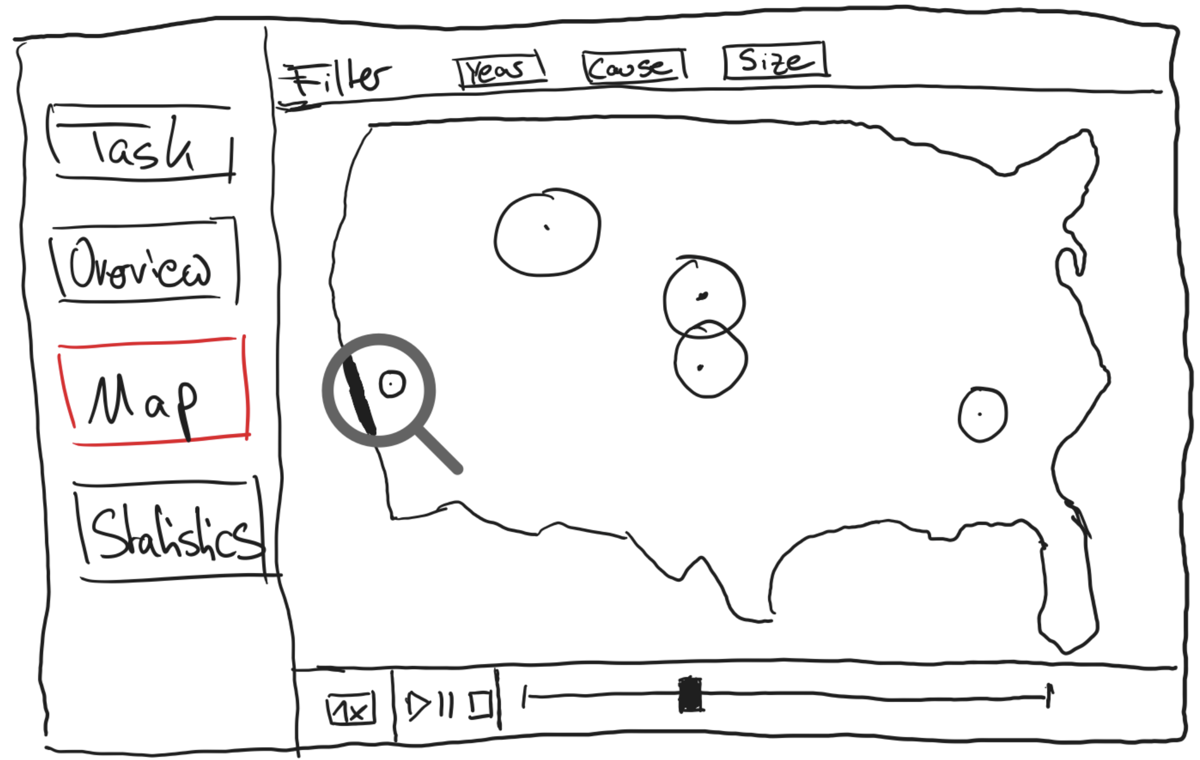
Design
Information
Title: Wildfire Visualization
Authors: Pascal Niemann, Tim Cares
Date: 11.05.2023
Task: Project work in HCI – Develop an interactive visualization application
Sheet number: 5
Operations
- Click on “Task” button => Show information about the task for this project work in the area, where the map would normally be
- Click on “Overview” => Show details about this application
- Click on “Map” => Show visualization of US wildfires (main)
- Click on “Statistics” => Show graphs about e.g. wildfires per year, wildfires by cause etc. (additional)
- Set categorical filters in the header when navigating on the map section => Only show wildfires based on selected characteristics
- When clicking on play or moving the time slider => Wildfires are
dynamically animated throughout the year or multiple years,
depending on if one specific year was selected in the filter
- Click on pause or stop icon => Pauses the animation or resets it accordingly
- Selection of a multiplicator => Adjusts the speed of the wildfire animation
- Hover of a wildfire => Display additional information including: area affected, location, date of discovery, date of control
Discussion
- Underlying dataset contains over 2 million wildfires over approximately
30 years, making it a very extensive task where this mount might be too many. Also, it will be computationally expensive.
- A solution could be to take a smaller subset, or filtering the wildfires using
functionalities of the application (see above)
- Depending on the size of the wildfires, some might not be visible due to a
small size or a short timespan
- Most difficult part will be aligning the position of the wildfires with the
map and animating the correct size
Focus
- Core of the application and therefore main focus will be visualizing
wildfires on the map over time
- As most of the wildfires won’t span thousands of miles, visualizing them not on a scale of 1:1 might be a viable choice

